Slide 1
Sequential Logic Design

Slide 2
Introduction
Sequential circuit
  Output depends not just on present inputs (as in combinational circuit), but on past sequence of inputs
    Stores bits, also known as having “state”
  Simple example: a circuit that counts up in binary
we will:
  Design a new building block, a flip-flop, that stores one bit
  Combine that block to build multi-bit storage
  register
  Describe the sequential behavior using a finite state machine
  Convert a finite state machine to a controller – a sequential circuit having a register and combinational logic
1
a
1
0
Combinational
digital circuit
F
b
1
a
Sequential
digital circuit
?
0
F
b
Must know sequence of past inputs to know output

Slide 3
Example Needing Bit Storage
Call
button
Blue light
Flight attendant call button
  Press call: light turns on
    Stays on after button released
  Press cancel: light turns off
  Logic gate circuit to implement this?
Bit
Storage
Cancel
button
1. Call button pressed – light turns on
Call
button
Blue light
Bit
Storage
a
Cancel
button
Call
Q
2. Call button released – light stays on
Cancel
a
Doesn’t work. Q=1 when Call=1, but doesn’t stay 1 when Call returns to 0
Call
button
Blue light
Bit
Storage
Cancel
button
Need some form of “feedback” in the circuit
3. Cancel button pressed – light turns off

Slide 4
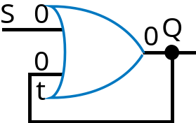

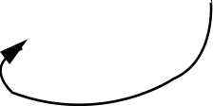
First attempt at Bit Storage
We need some sort of feedback
  Does circuit on the right do what we want?
    No: Once Q becomes 1 (when S=1), Q stays 1 forever – no value of S can bring Q back to 0
S
Q
t
S
1
S
1
Q
S
1
Q
S
0
Q
0
Q
1
1
1
a
0
0
1
1
t
t
t
t
S
1
0
t
1
0
Q
1
0

Slide 5

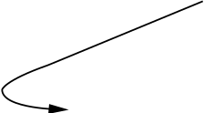
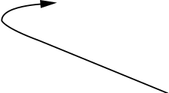
Bit Storage Using an SR Latch
Does the circuit to the right, with cross-coupled NOR gates, do what we want?
  Yes! How did someone come up with that circuit? Maybe just trial and error, a bit of insight...
S (set)
SR latch
Q
R (reset)
S=0
t
S=0
t
S=1
t
S=0
t
Recall…
0
1
0
1
1
0
1
0
0
0
1
1
1
0
0
1
Recall ...
0
Q
0
Q
1
Q
1
Q
X
0
R=1
R=0
R=0
R=0
S
1
0
R
1
0
a
t
1
0
Q
1
0

Slide 6
Example Using SR Latch for Bit Storage
SR latch can serve as bit storage in previous example of flight-attendant call button
  Call=1 : sets Q to 1
    Q stays 1 even after Call=0
  Cancel=1 : resets Q to 0
But, there’s a problem...
Blue lig
C
all
h
t
but
t
on
Bit
S
t
o
r
C
an
c
el
age
but
t
on
C
all
S
but
t
on
Blue lig
h
t
C
an
c
el
Q
but
t
on
R

Slide 7
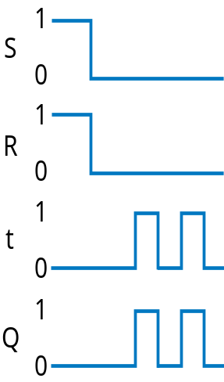
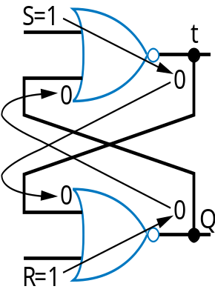
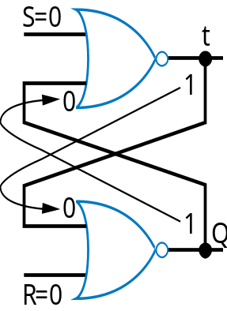
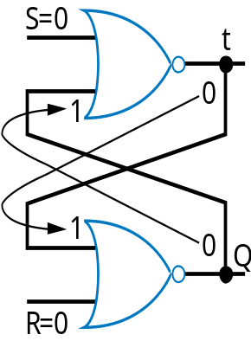

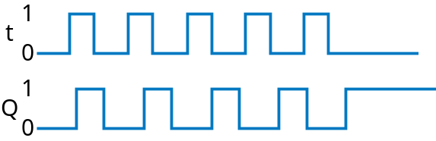
Problem with SR Latch
Problem
  If S=1 and R=1 simultaneously, we don’t know what value Q will take
Q may oscillate. Then, because one path will be slightly longer than the other, Q will eventually settle to 1 or 0 – but we don’t know which.

Slide 8
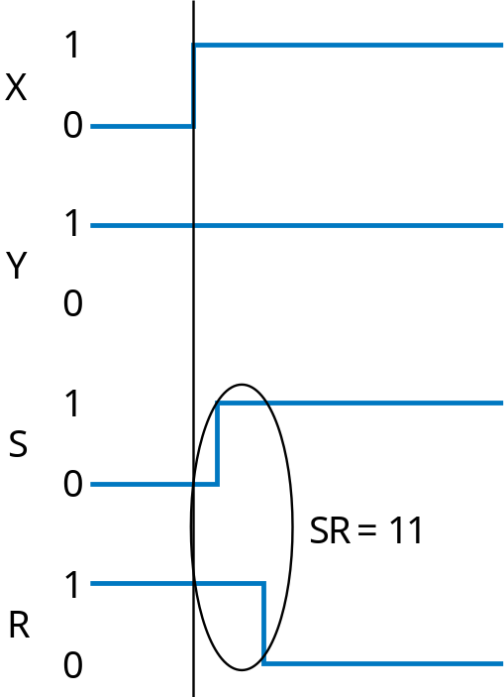
Problem with SR Latch
Problem not just one of a user pressing two buttons at same time
Can also occur even if SR inputs come from a circuit that supposedly never sets S=1 and R=1 at same time
  But does, due to different delays of different paths
A
r
bit
r
a
r
y
SR latch
X
circuit
S
Q
Y
R
The longer path from X to R than to S causes SR=11 for short time – could be long enough to cause oscillation

Slide 9
Solution: Level-Sensitive SR Latch
Add enable input “C” as shown
  Only let S and R change when C=0
    Enure circuit in front of SR never sets SR=11, except briefly due to path delays
  Change C to 1 only after sufficient time for S and R to be stable
  When C becomes 1, the stable S and R value passes through the two AND gates to the SR latch’s S1 R1 inputs.
Level-sensitive SR latch
S
S1
C
Q
R
R1
Though SR=11 briefly...
S
Q
’
Level-sensitive SR latch
1
C
Q
S
S
0
R
X
S1
R
1
Level-sensitive SR latch symbol
0
Clk
C
1
a
C
0
Q
S1
1
R
R1
0
Y
R1
1
0
...S1R1 never = 11

Slide 10
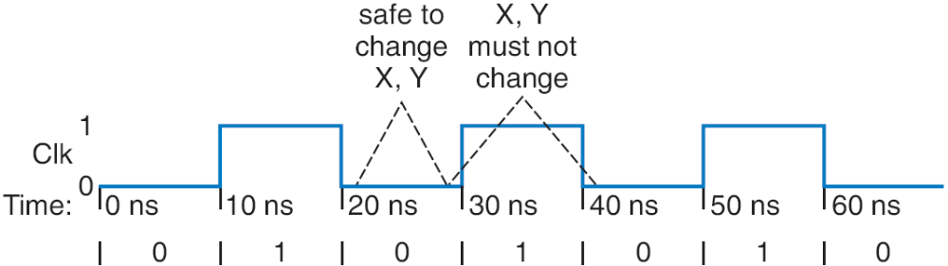
Clock Signals for a Latch
How do we know when it’s safe to set C=1?
  Most common solution –make C pulse up/down
    C=0: Safe to change X, Y
    C=1: Must not change X, Y
    We’ll see how to ensure that later
  Clock signal -- Pulsing signal used to enable latches
    Because it ticks like a clock
  Sequential circuit whose storage components all use clock signals: synchronous circuit
    Most common type
    Asynchronous circuits – important topic, but left for advanced course
Level-sensitive SR latch
X
S
S1
Clk
C
Q
R
R1
Y

Slide 11
Clocks
Clock period: time interval between pulses
  Above signal: period = 20 ns
Clock cycle: one such time interval
  Above signal shows 3.5 clock cycles
Clock frequency: 1/period
  Above signal: frequency = 1 / 20 ns = 50 MHz
    1 Hz = 1/s
Freq
Period
100 GHz
0.01 ns
10 GHz
0.1 ns
1 GHz
1 ns
100 MHz
10 ns
10 MHz
100 ns

Slide 12
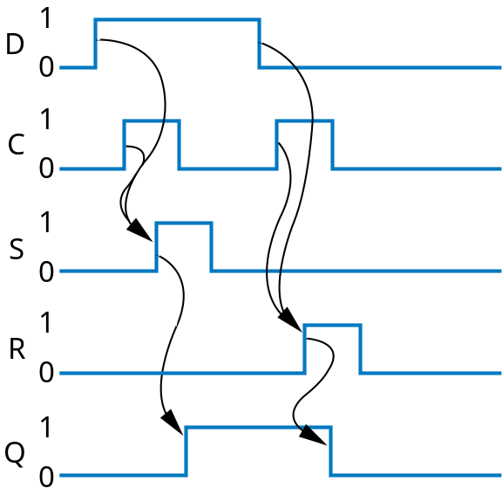
Level-Sensitive D Latch
SR latch requires careful design to ensure SR=11 never occurs
D latch relieves designer of that burden
  Inserted inverter ensures R always opposite of S
D latch
D
S
C
Q
R
D
Q
’
C
Q
D latch symbol

Slide 13
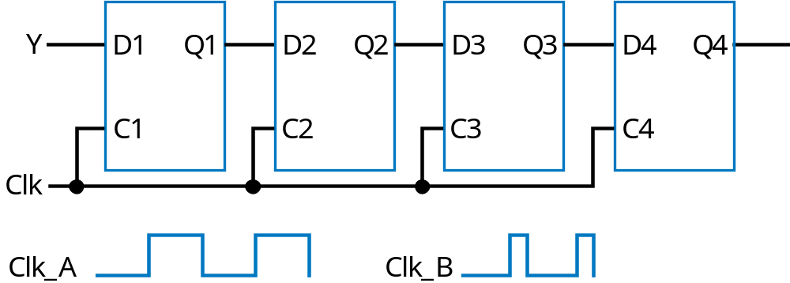
Problem with Level-Sensitive D Latch
D latch still has problem (as does SR latch)
  When C=1, through how many latches will a signal travel?
  Depends on for how long C=1
    Clk_A -- signal may travel through multiple latches
    Clk_B -- signal may travel through fewer latches
  Hard to pick C that is just the right length
    Can we design bit storage that only stores a value on the rising edge of a clock signal?
rising edges
Clk

Slide 14
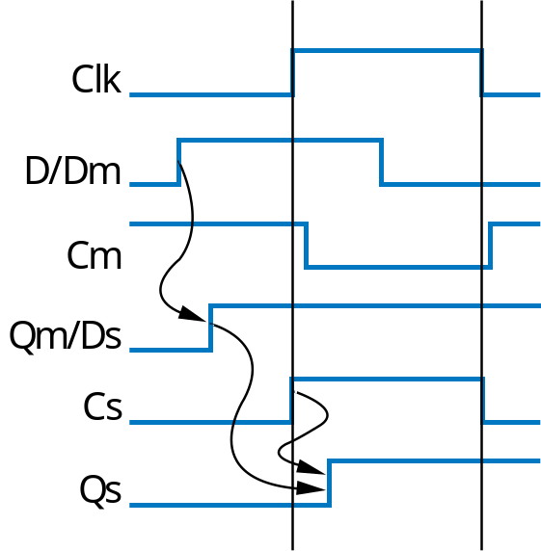
D Flip-Flop
Flip-flop: Bit storage that stores on clock edge, not level
One design -- master-servant
  Two latches, output of first goes to input of second, master latch has inverted clock signal
  So master loaded when C=0, then servant when C=1
  When C changes from 0 to 1, master disabled, servant loaded with value that was at D just before C changed -- i.e., value at D during rising edge of C
rising edges
Clk
Note: Hundreds of different flip-flop designs exist
D flip-flop
D latch
D latch
D
Q
’
Dm
Qm
Ds
Q
s
’
C
m
Cs
Qs
Q
master
servant
Clk

Slide 15
D Flip-Flop
D
Q
’
D
Q
’
Internal design: Just invert servant clock rather than master
The triangle means clock input, edge triggered
Q
Q
Symbol for rising-edge
triggered D flip-flop
Symbol for falling-edge
triggered D flip-flop
rising edges
falling edges
Clk
Clk

Slide 16
D Flip-Flop
Solves problem of not knowing through how many latches a signal travels when C=1
  In figure below, signal travels through exactly one flip-flop, for Clk_A or Clk_B
  Why? Because on rising edge of Clk, all four flip-flops are loaded simultaneously -- then all four no longer pay attention to their input, until the next rising edge. Doesn’t matter how long Clk is 1.
Y
D1
Q1
D2
Q2
D3
Q3
D4
Q4
Two latches inside each flip-flop
Clk
Clk_A
Clk_B

Slide 17
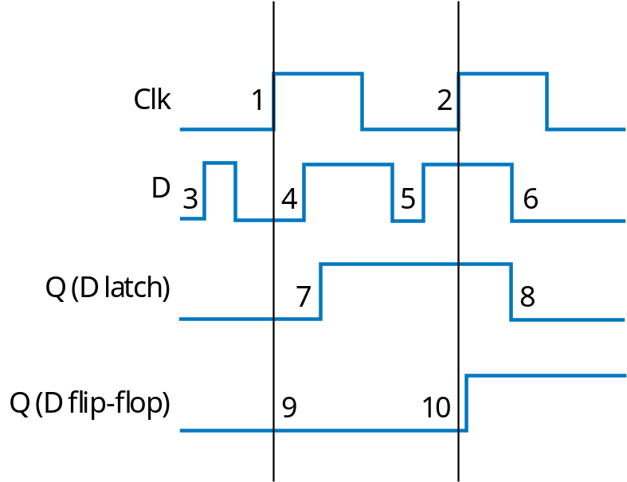
D Latch vs. D Flip-Flop
Latch is level-sensitive: Stores D when C=1
Flip-flop is edge triggered: Stores D when C changes from 0 to 1
  Saying “level-sensitive latch,” or “edge-triggered flip-flop,” is redundant
  Two types of flip-flops -- rising or falling edge triggered.
Comparing behavior of latch and flip-flop:

Slide 18
Bit Storage Summary
SR latch
Level-sensitive SR latch
D latch
D flip-flop
S (set)
S
S1
D
S
D latch
D latch
D
Dm
Qm
Ds
Qs’
Q
’
C
C
Q
C
m
Cs
Qs
Q
R
Q
Q
master
servant
R (reset)
R1
R
Clk
Feature: S=1 sets Q to 1, R=1 resets Q to 0. Problem: SR=11 yield undefined Q.
Feature: S and R only have effect when C=1. We can design outside circuit so SR=11 never happens when C=1. Problem: avoiding SR=11 can be a burden.
Feature: SR can’t be 11 if D is stable before and while C=1, and will be 11 for only a brief glitch even if D changes while C=1. Problem: C=1 too long propagates new values through too many latches: too short may not enable a store.
Feature: Only loads D value present at rising clock edge, so values can’t propagate to other flip-flops during same clock cycle. Tradeoff: uses more gates internally than D latch, and requires more external gates than SR – but gate count is less of an issue today.
We considered increasingly better bit storage until we arrived at the robust D flip-flop bit storage

